Slide 1

MINI PROJECT 2020-21 (15ECSW301) Meme Classification
Team : E5.
Guide : Dr P.G.Sunita Hiremath.
TEAM Members:
* Varun Bohara. 01fe18bcs278
* Sakshi Tahlani. 01fe18bcs271
* Abhishek Rao. 01fe18bcs297
* Madhurika Ganiger. 01fe18bcs284

Slide 2
OUTLINE
INTRODUCTION
MOTIVATION
PROBLEM STATEMENT
OBJECTIVES
LITERATURE SURVEY
PROPOSED METHODOLOGY
REQUIREMENT ANALYSIS
REFERENCES

Slide 3
INTRODUCTION
“Memes” are cultural inside jokes, a way of connecting with people across internet through instantly recognizable photos. They collect emotions, ideas and actions into an easy-to-translate format.
Rise of memes : Besides reflecting humour ,the rise of memes has shown to be having a harmful effect on an individual as well as political, religional , communal sectors of society.
Data: Meme as an image along with embedded text .
Features: Image and text features , in the form of embedding vetors .
Multimodal Models: Interpretation of memes using multimodal models .

Slide 4
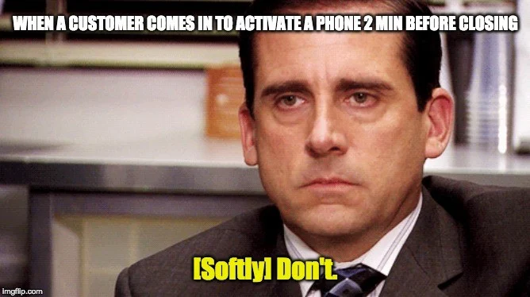
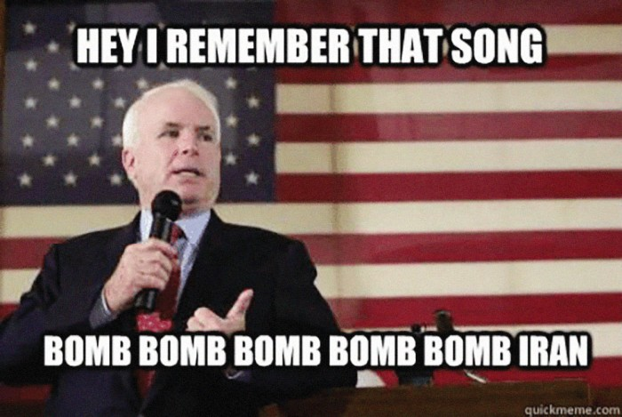

MOTIVATION

Slide 5
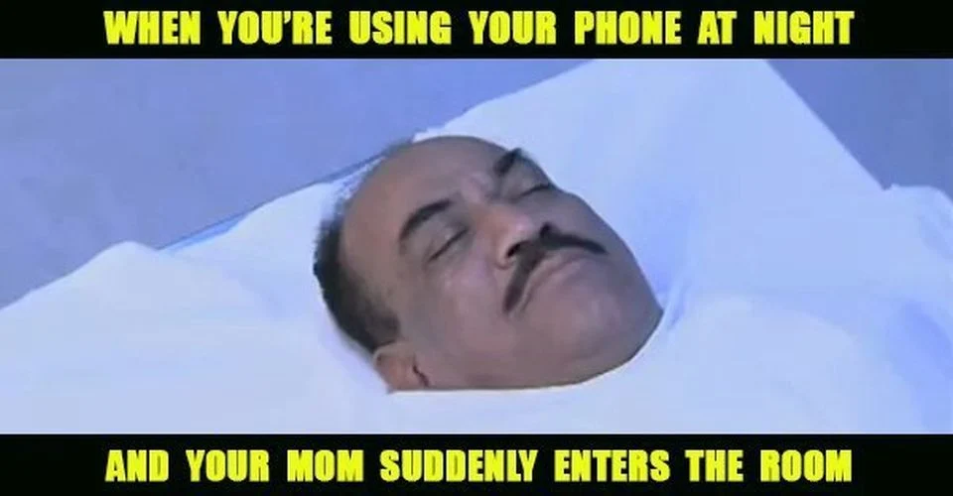

PROBLEM STATEMENT
To label a meme as hateful or non-hateful by creating a model that identifies multimodal hate speech in them.
Input
Output
Non Hateful(0)
Hateful(1)

Slide 6
OBJECTIVES
To generate embeddings of image and text .
To fuse the text and image embeddings and build a classifier.
To evaluate the performace of the multimodal model using AUC ROC.

Slide 7
LITERATURE SURVEY

Slide 8
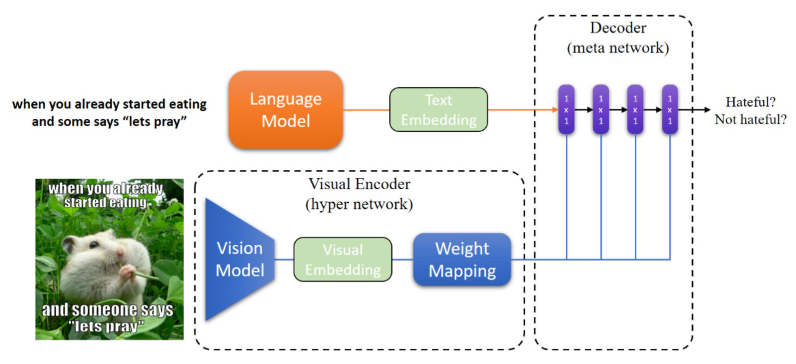
Hateful Memes Challenge 2020, SEP 22 Yuval Nirkin Assaf Rabinowitz Yoni Solel
Data Processing
Text embedding :SBERT
Image Embedding: MobileNetV2
Hypernetworks
Decoder
Varun Bohara

Slide 9
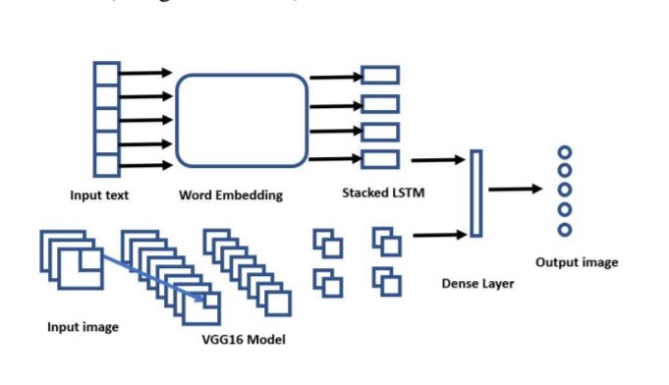
Multimodal Meme Dataset (MultiOFF) for Identifying Offensive Content in Image and Text Shardul Suryawanshi, Bharathi Raja Chakravarthi, Mihael Arcan, Paul Buitelaar
Text Embedding : LSTM
Image Embedding : VGG16
Early Fusion Method

Slide 10
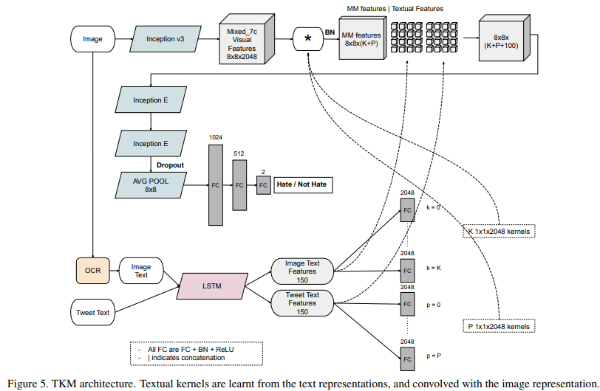
Exploring Hate Speech Detection in Multimodal Publications ( WACV, 2020) [1]
TKM( Textual Kernels Model ):
Inception Model
Kernel
LSTM Model

Slide 11
PROPOSED METHODOLOGY
Image Module
Input
Decoder
Performance Evaluation
Visual Module
Output
Hateful (1)

Slide 12
REQUIREMENT ANALYSIS
Functional
The model shall be able to generate image and text representations .
The model shall be able to classify the meme as hateful or non hateful using provided embeddings .
The model shall be able to generate the probability of the meme being hateful .
Non Functional
The model should be atleast 70% accurate .
The model should not under-perform on limited computing resources.

Slide 13
REFERENCES
https://nirkin.com/hateful-memes/
https://www.aclweb.org/anthology/2020.trac-1.6.pdf
https://arxiv.org/pdf/1910.03814.pdf

Slide 14

Hypernetworks
In a typical deep network , the majority of parameters are in the kernels of convolutional layers.
Each kernel contain N_{in} × N_{out} filters and each filter has dimensions f_{size} × f_{size}.
For each layer j, the hypernetwork receives a layer embedding z^{j} ∈ R^{Nz} as input and predicts K^{j}, which can be generally written as follows:
K^{j} = g(z^{j} ), ∀j = 1, ..., D
K¹
...........
K^{D}
N_{in}.f_{size}×N_{out}f_{size}
N_{in}.f_{size}×N_{out}f_{size}

